Slide 1
A5: Low-Fi Prototyping & Usability Testing
10/08
10/19
SparkBook

Slide 2
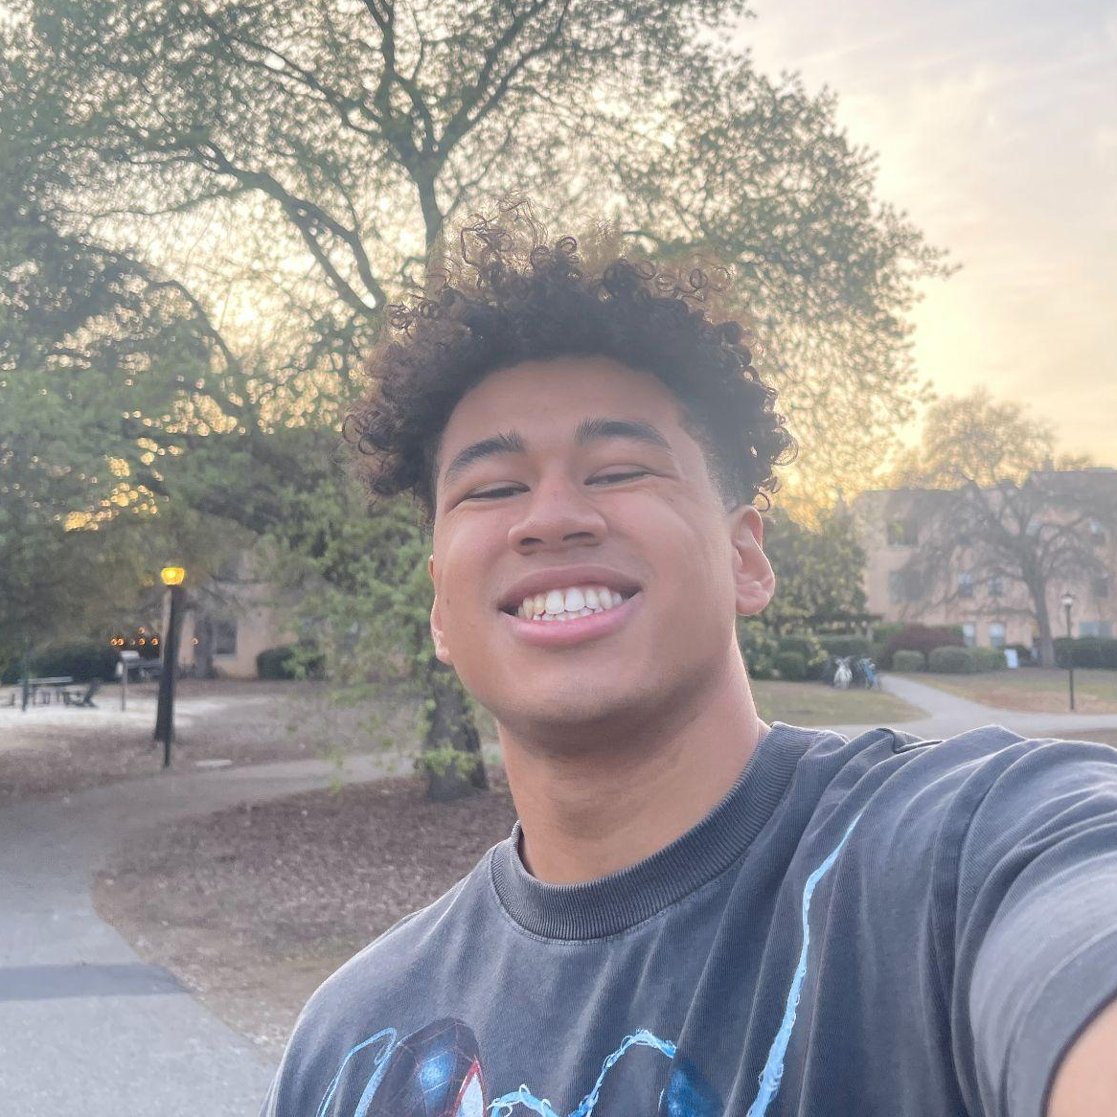



Team
Elijah
Luiza
Claire
Mikela
Symbolic Systems ‘26
Design + CS ‘28
Computer Science ‘27
Symbolic Systems ‘27

Slide 3

“Spark your creativity.”
Notes:
a. How did your team land on the name? b. One-liner value proposition that conveys what customers get out of your product (e.g., Stripe “Payment infrastructure for the Internet”) c. Sanity check: could your value proposition be applicable to many other apps or is it particular to yours? You want the latter.

Slide 4
Value proposition
“Spark your creativity.”
SparkBook’s value proposition encapsulates the experience we want the user to have using the app: facilitating the creativity process for artists.
Team 2

Slide 5
Problem
Solution
SparkBook
Artists struggle to effectively and quickly store all of their various sources of inspiration in a centralized and organized structure. This makes it harder for them to go back to these sources when they are creating art.
A digital notebook that allows artists to store multimedia sources of inspiration while smarty organizing them based on their chosen categories.

Slide 6
Index
Team 2
1
2
3
4
Sketching
Exploration
Low-fi
Prototype
Usability
Testing
Discussion

Slide 7
Solution Ideas

Slide 8
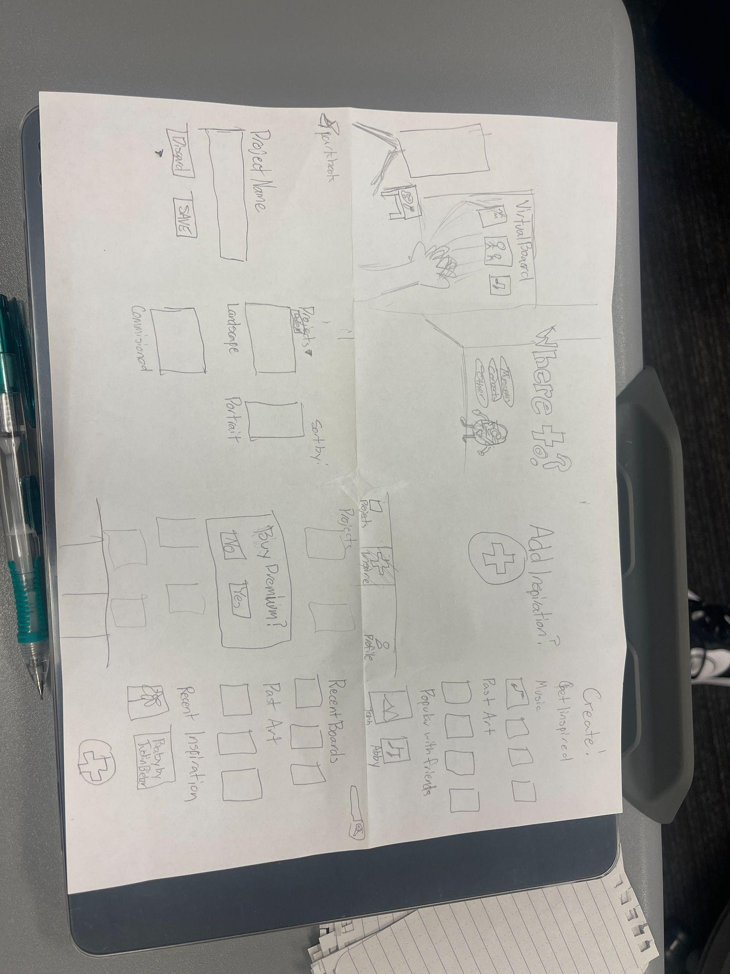
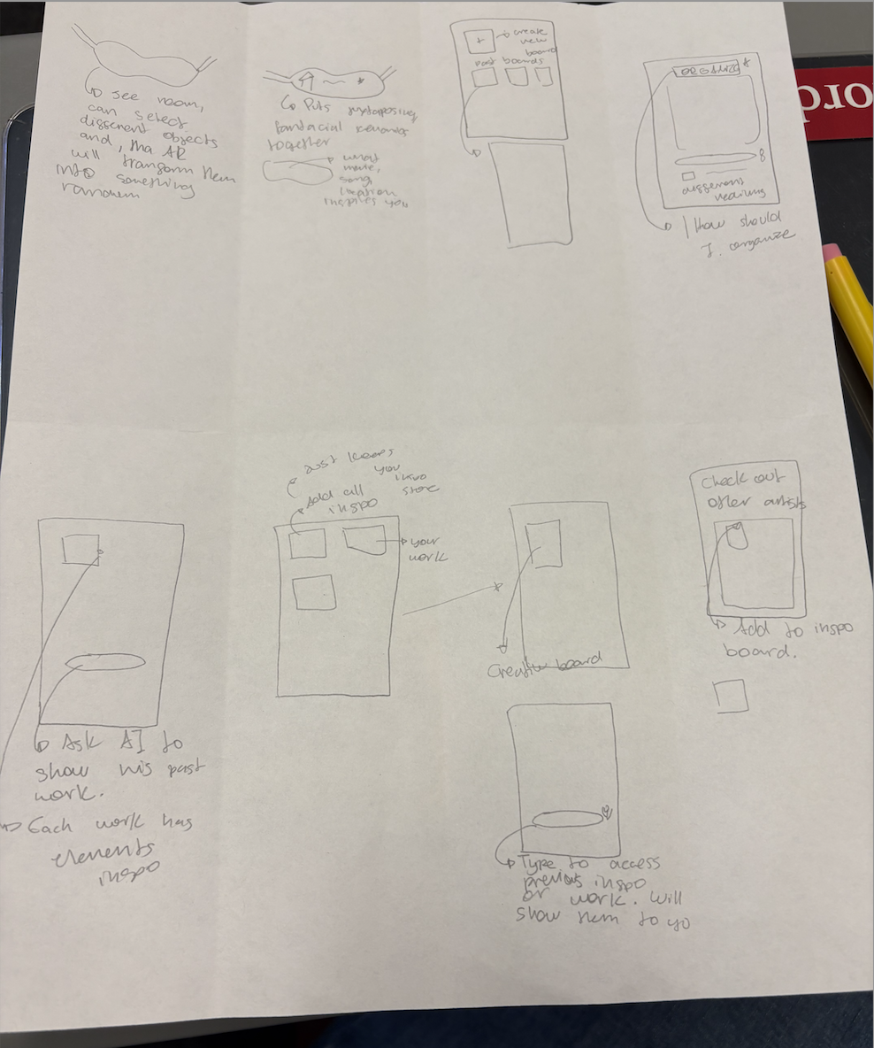
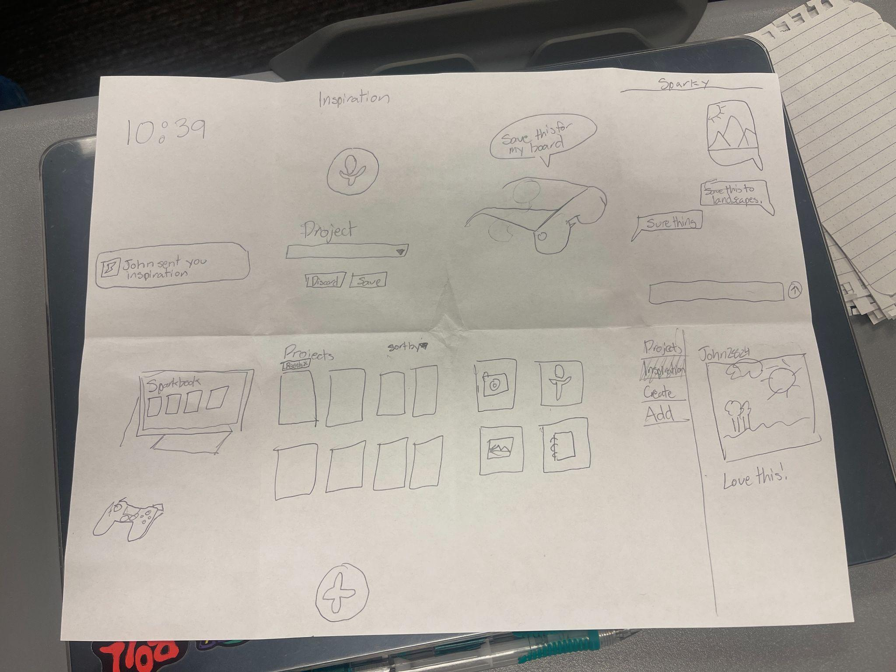
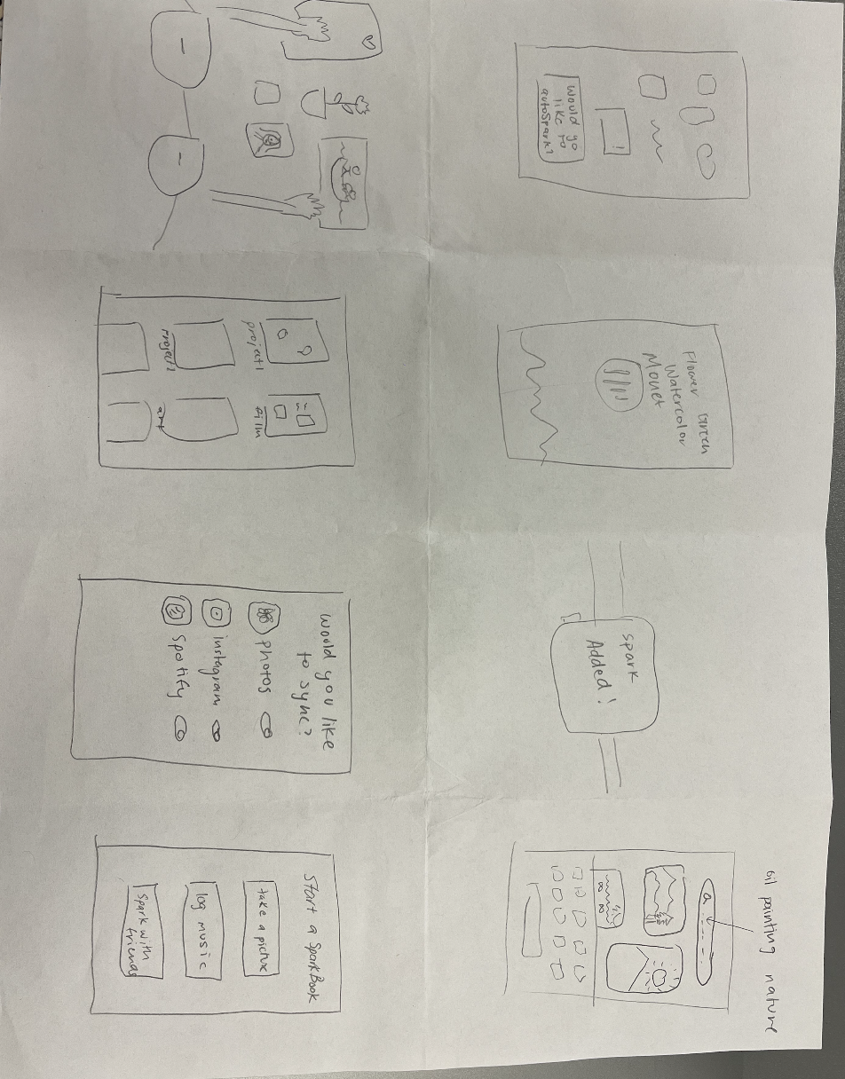
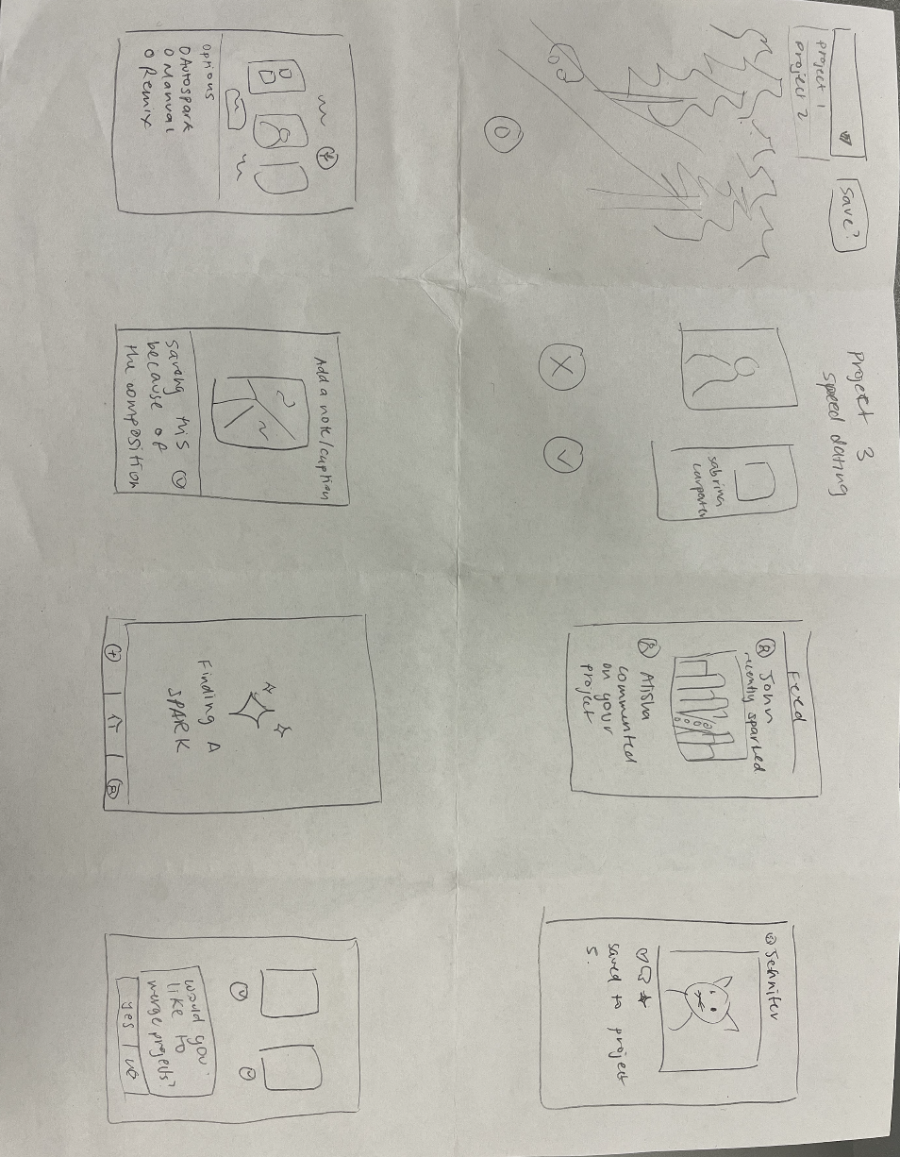
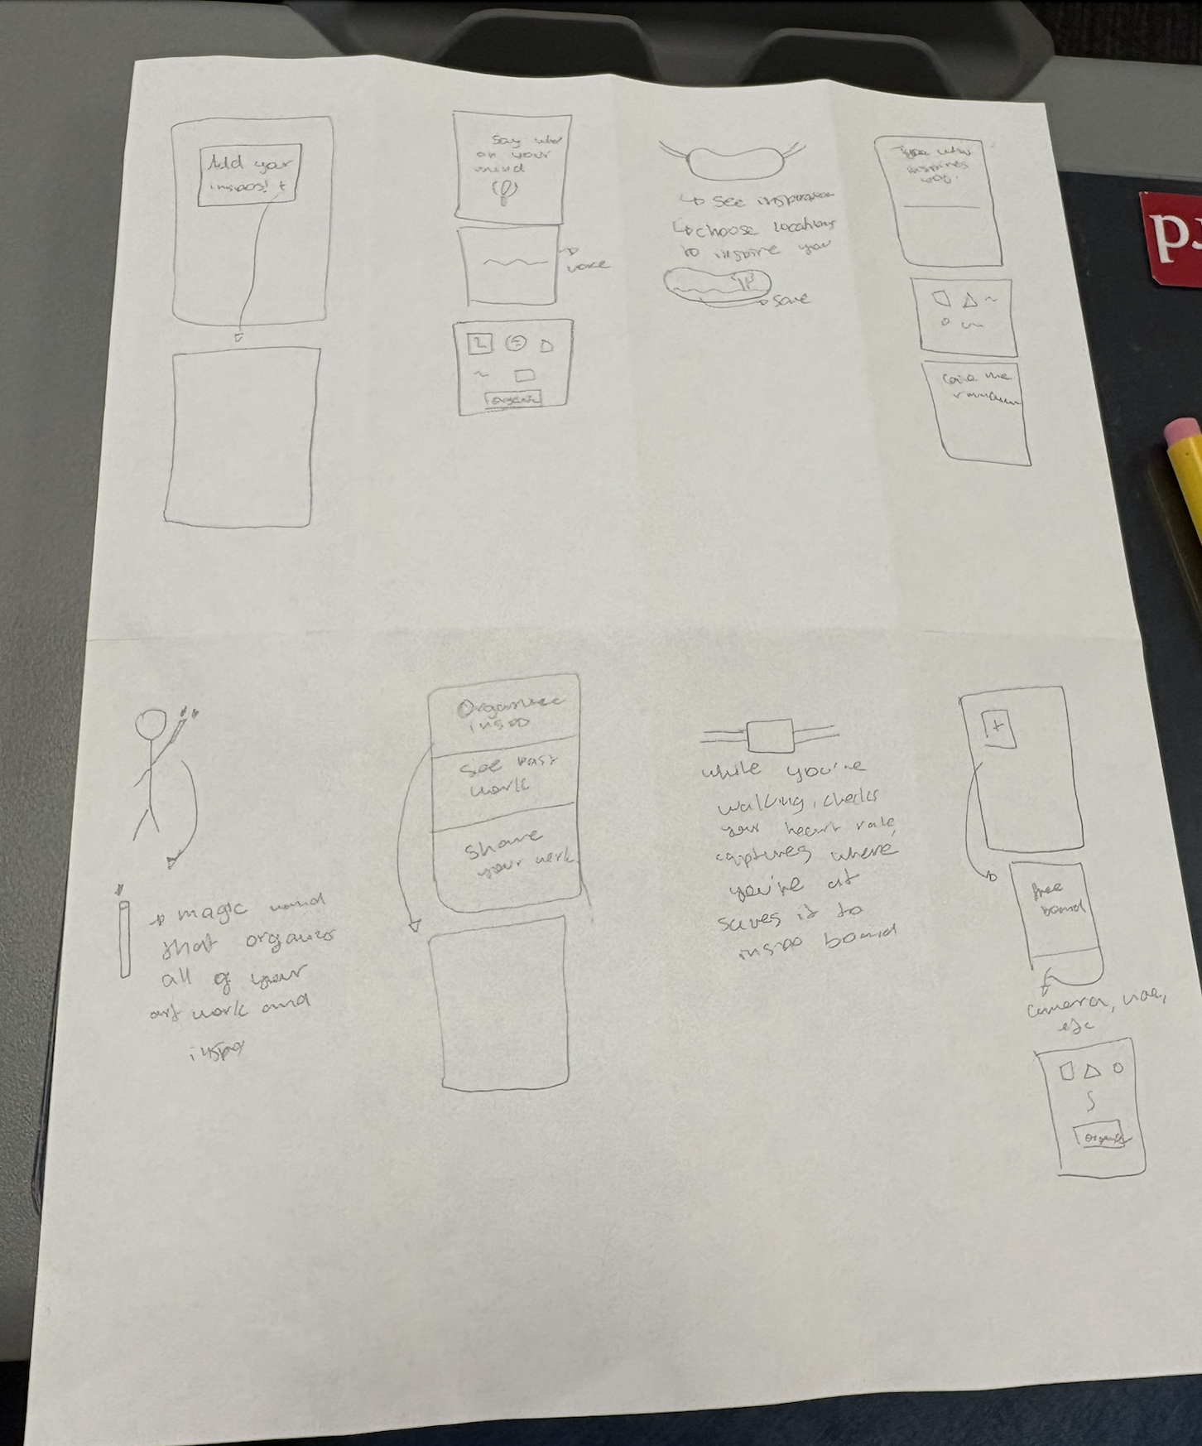
Solution Ideas
Notes:
What are some similarities and differences between the products? What has (and has not) worked for them? What makes your solution concept unique? What are the implications on your solution?

Slide 9
Solution Ideas: Highlights
AR Virtual Board
Unique sorting options on mobile
Gamification?
Notes:
What are some similarities and differences between the products? What has (and has not) worked for them? What makes your solution concept unique? What are the implications on your solution?

Slide 10
Chosen realizations

Slide 11
Chosen Realizations
Smart Watch
Mobile App
Augmented Reality
Notes:
What are some similarities and differences between the products? What has (and has not) worked for them? What makes your solution concept unique? What are the implications on your solution?

Slide 12
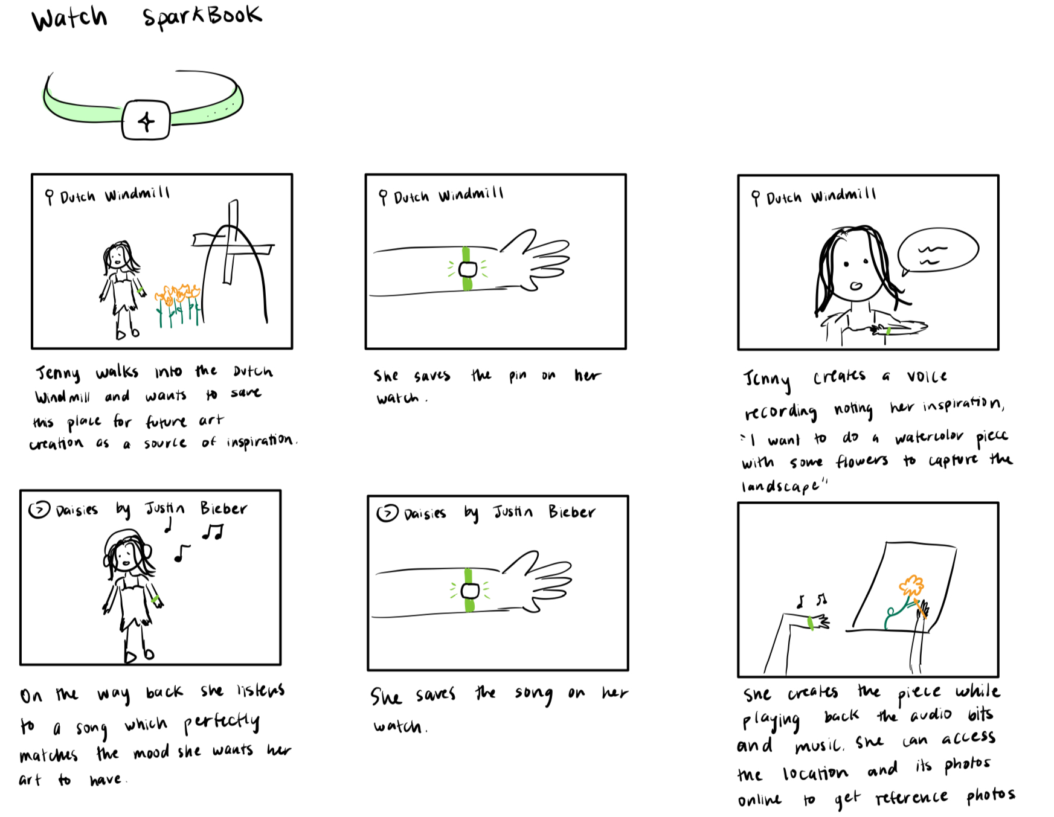
Smart Watch Concept Sketch
Notes:
What are some similarities and differences between the products? What has (and has not) worked for them? What makes your solution concept unique? What are the implications on your solution?

Slide 13
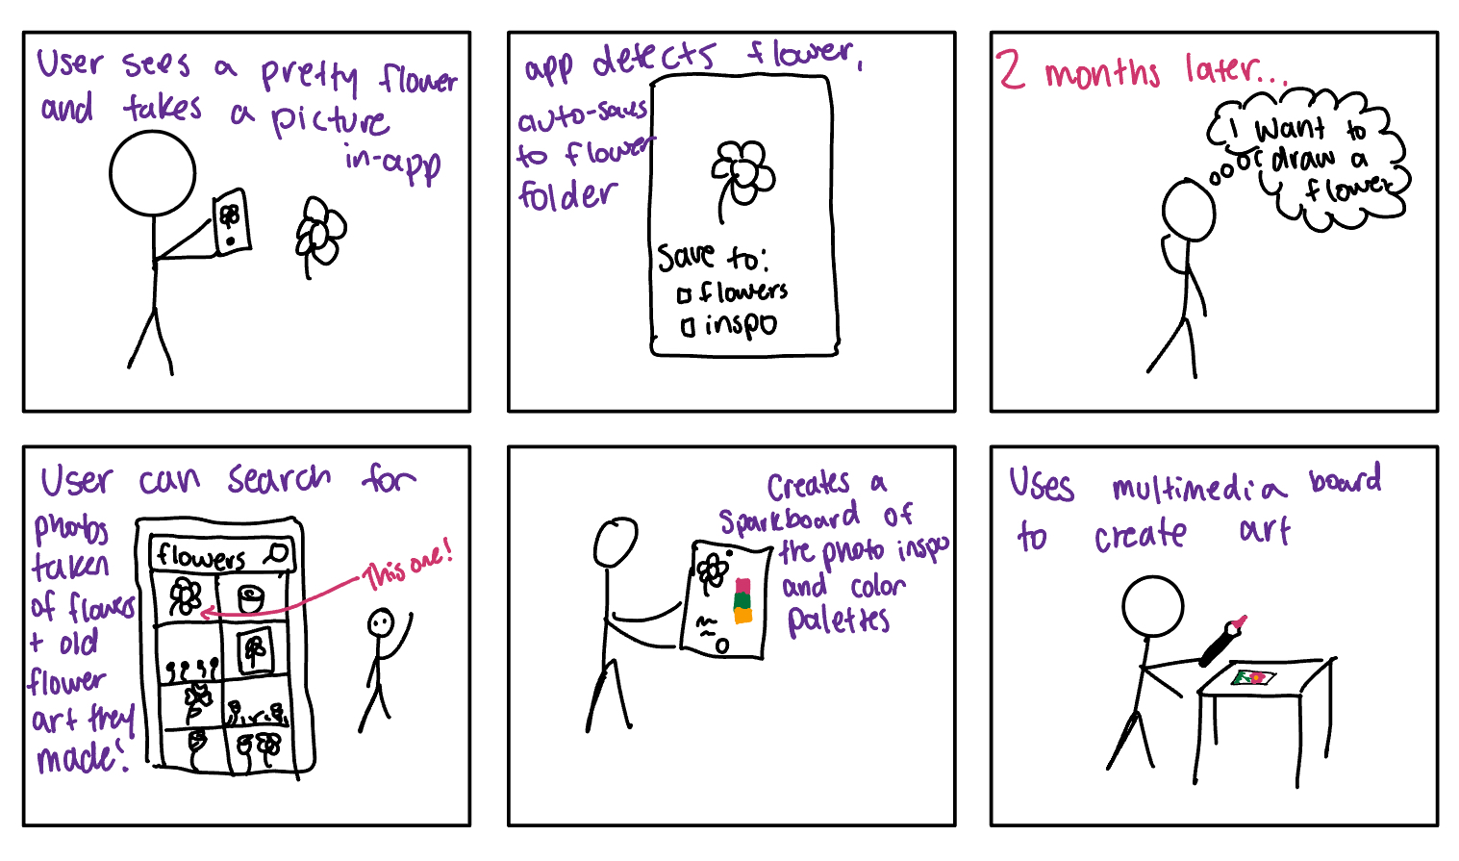
Mobile App Concept Sketch
Notes:
What are some similarities and differences between the products? What has (and has not) worked for them? What makes your solution concept unique? What are the implications on your solution?

Slide 14
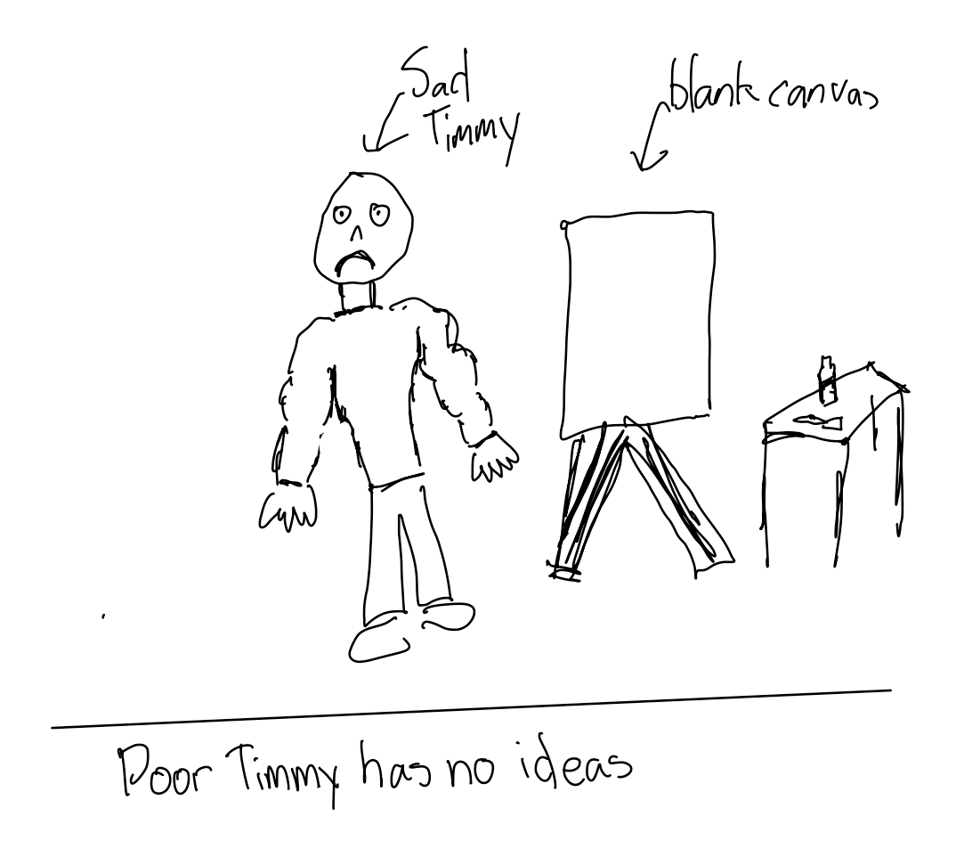
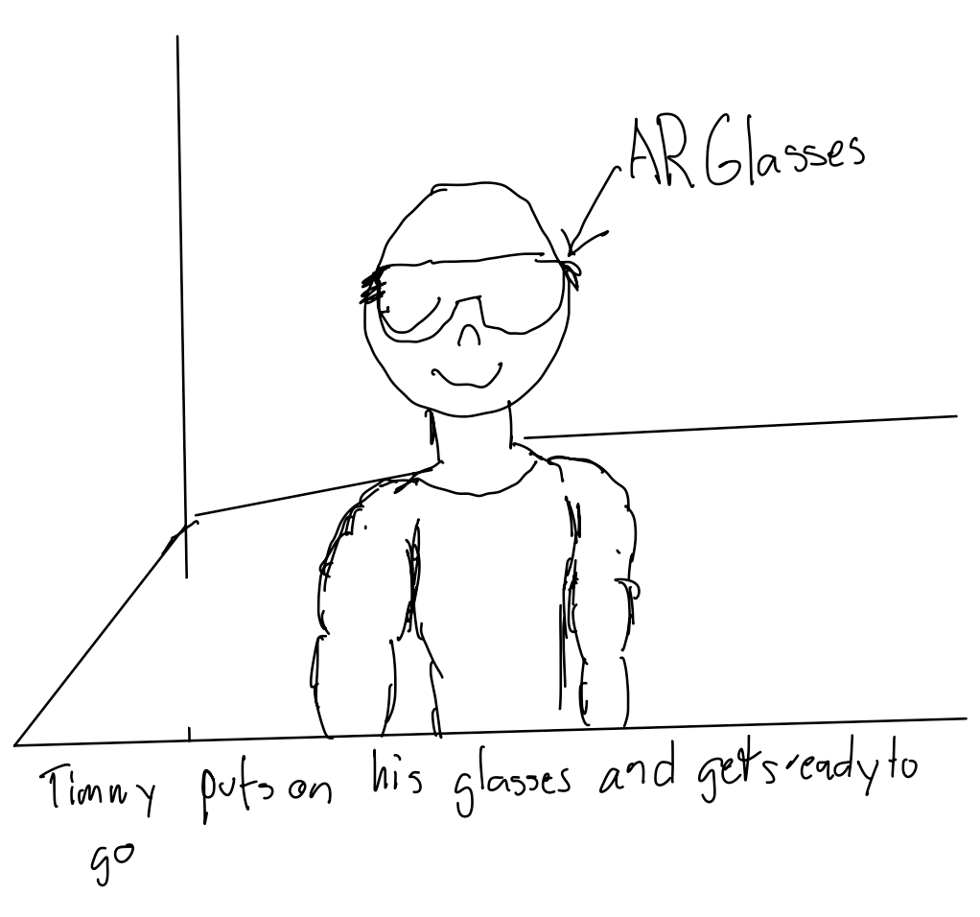
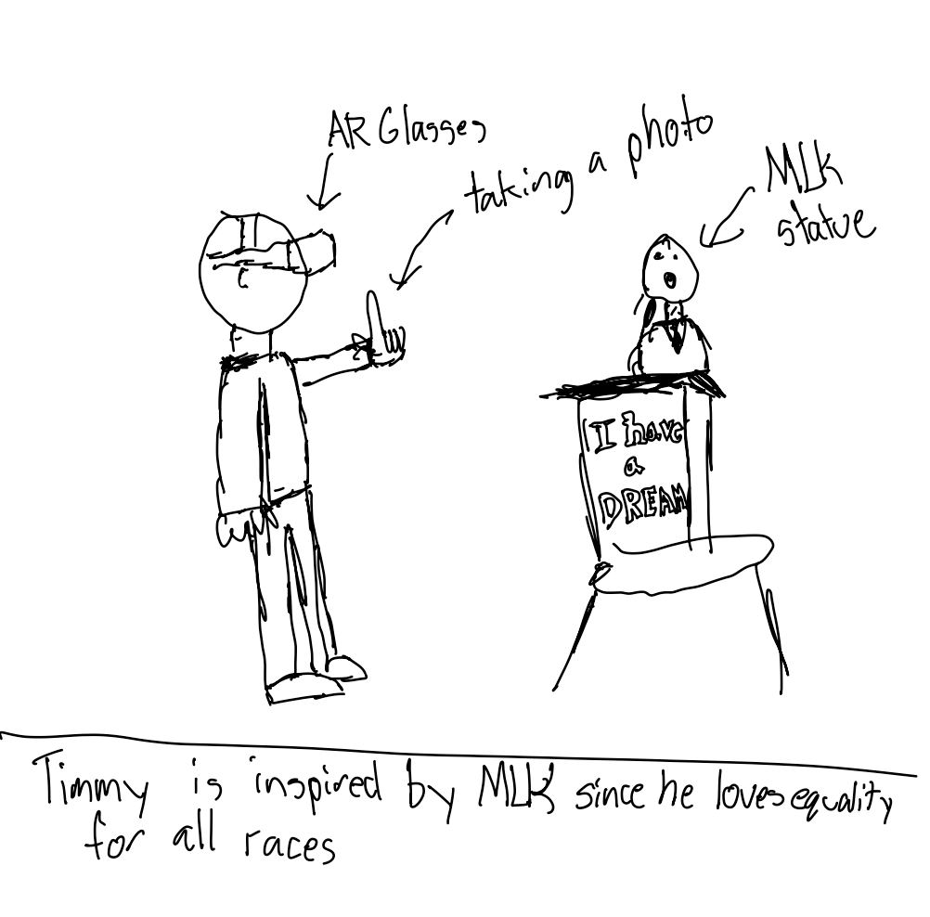
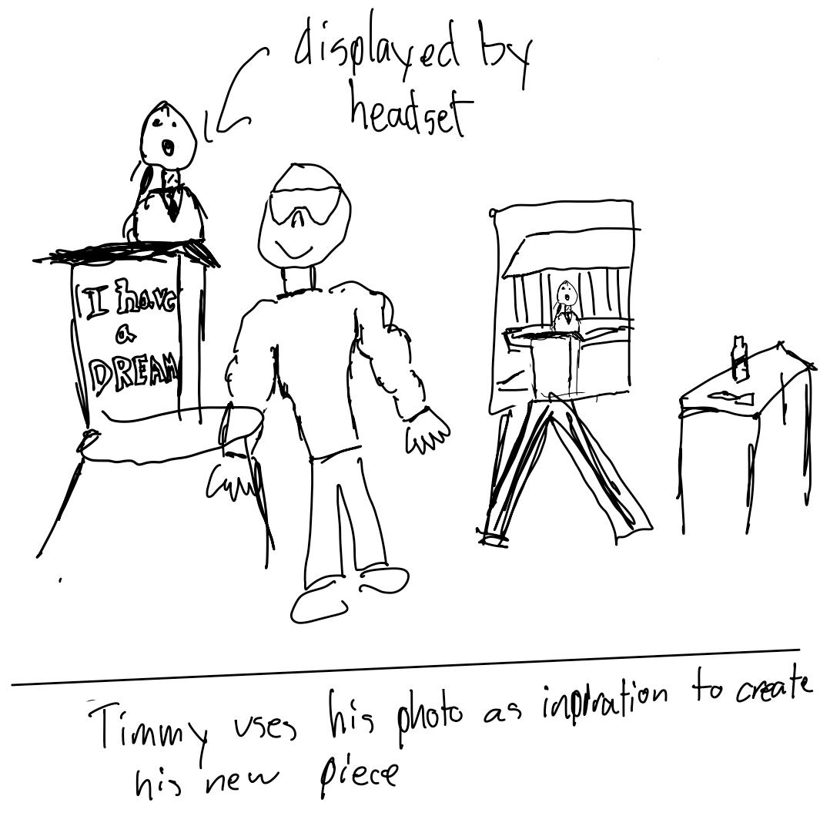
AR Concept Sketch
Notes:
What are some similarities and differences between the products? What has (and has not) worked for them? What makes your solution concept unique? What are the implications on your solution?

Slide 15
Top 2 Realizations

Slide 16
Top 2 Realizations
Mobile App
Augmented Reality
Notes:
What are some similarities and differences between the products? What has (and has not) worked for them? What makes your solution concept unique? What are the implications on your solution?

Slide 17
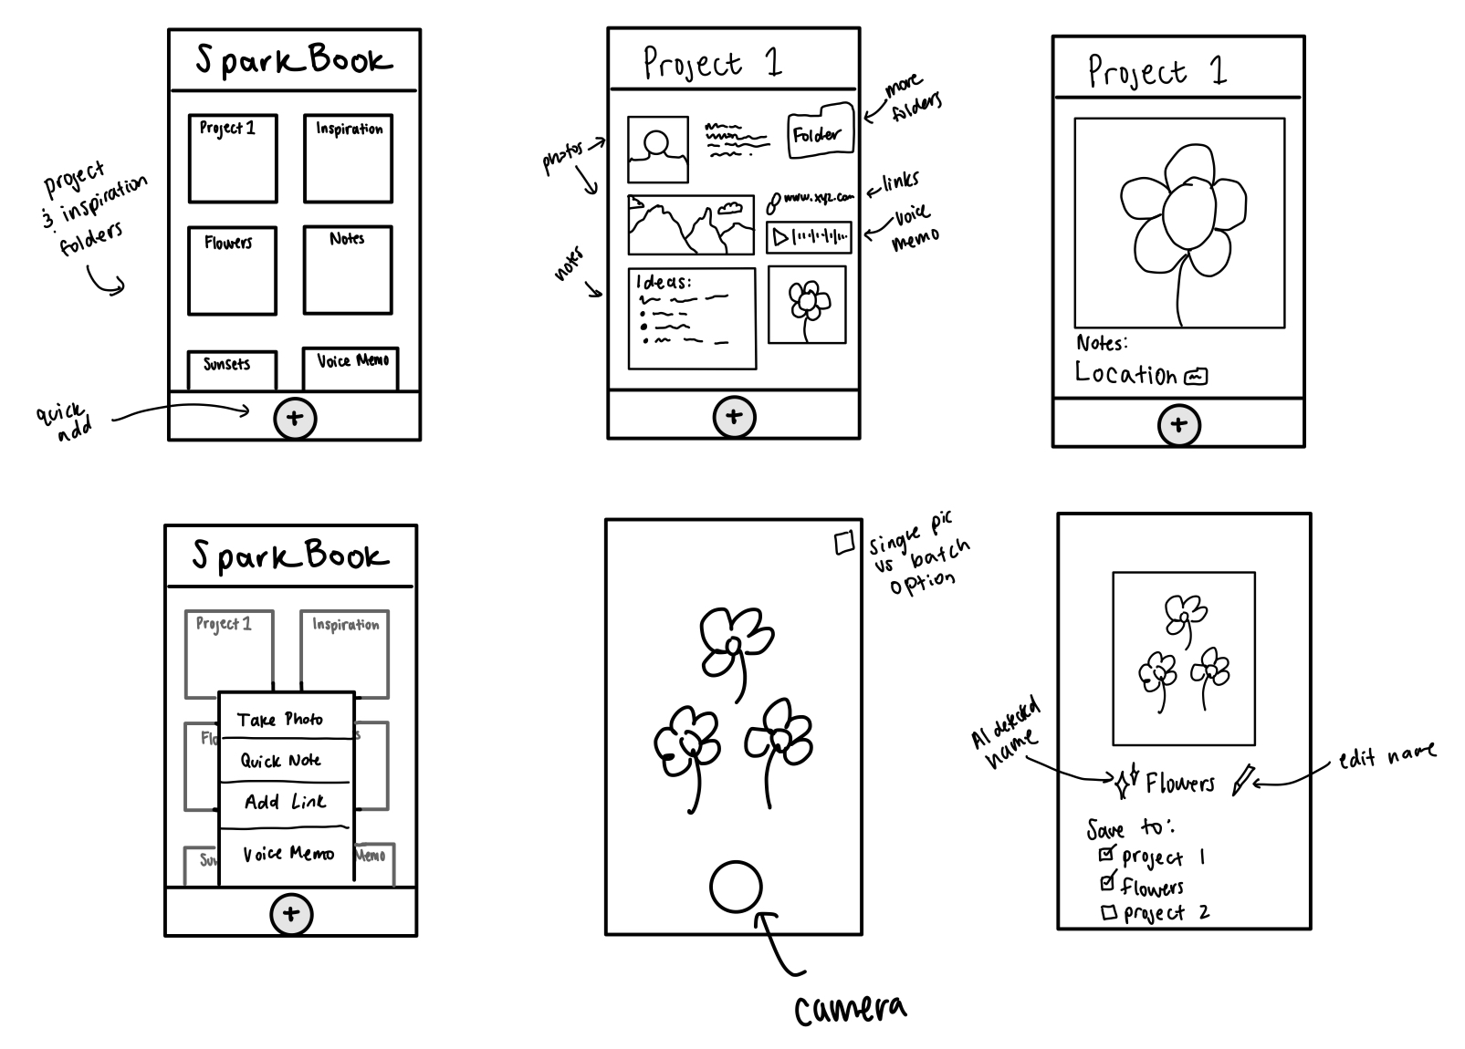
Mobile App screens
Notes:
What are some similarities and differences between the products? What has (and has not) worked for them? What makes your solution concept unique? What are the implications on your solution?

Slide 18
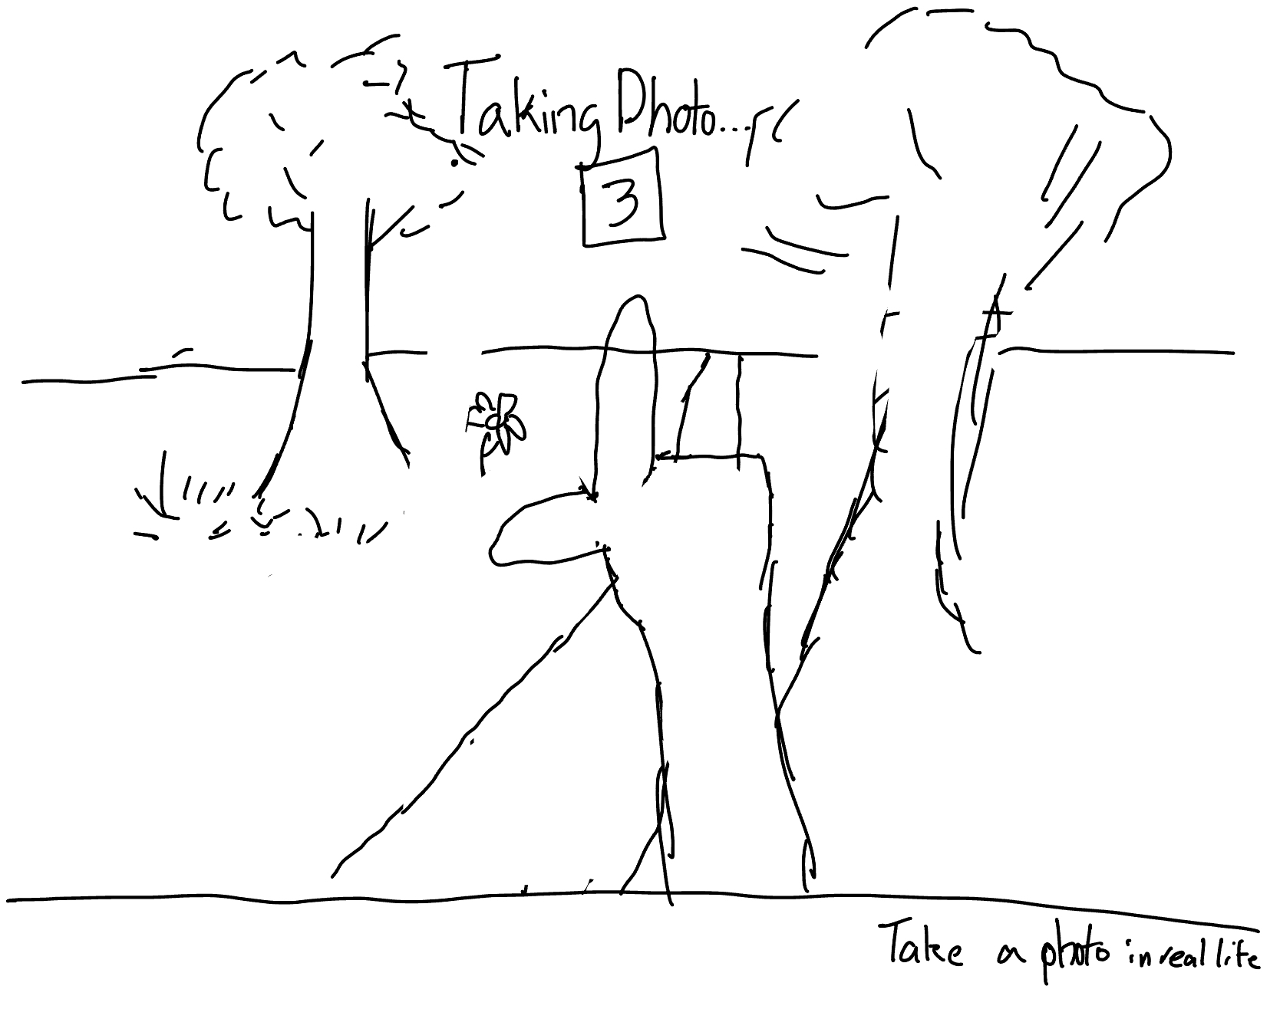
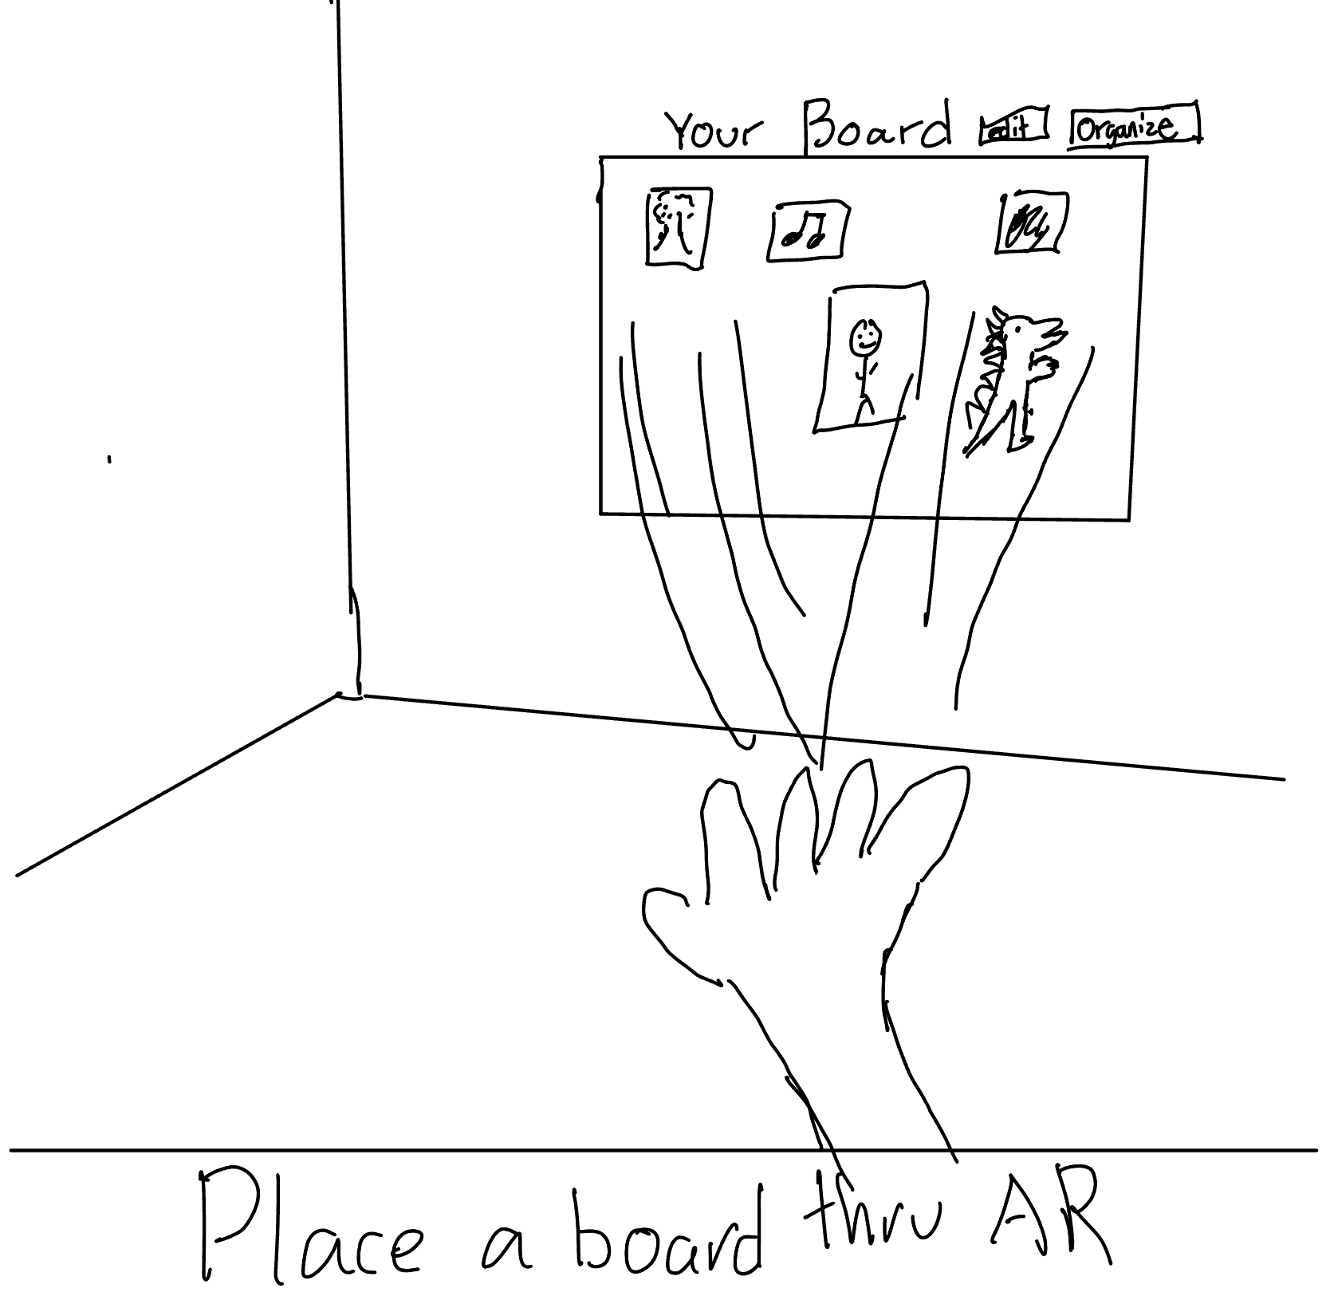
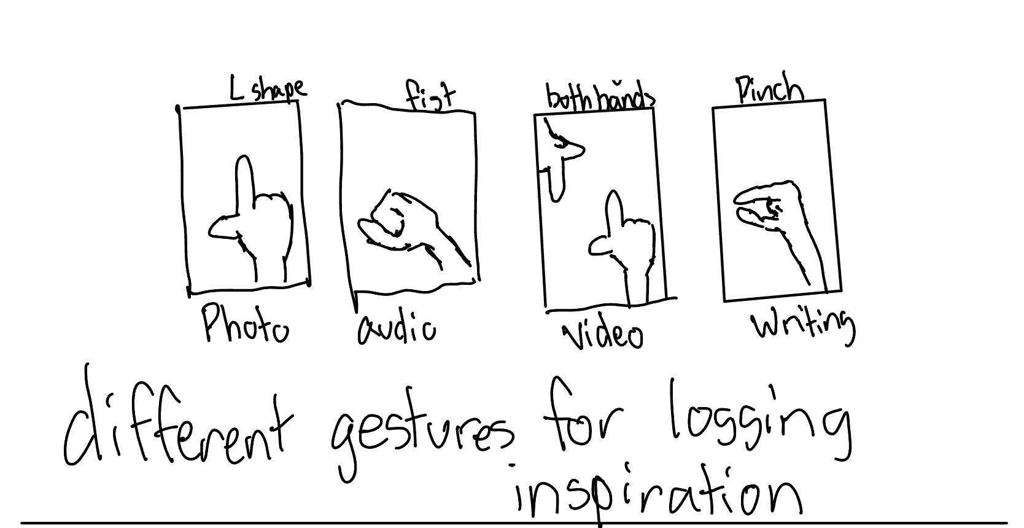
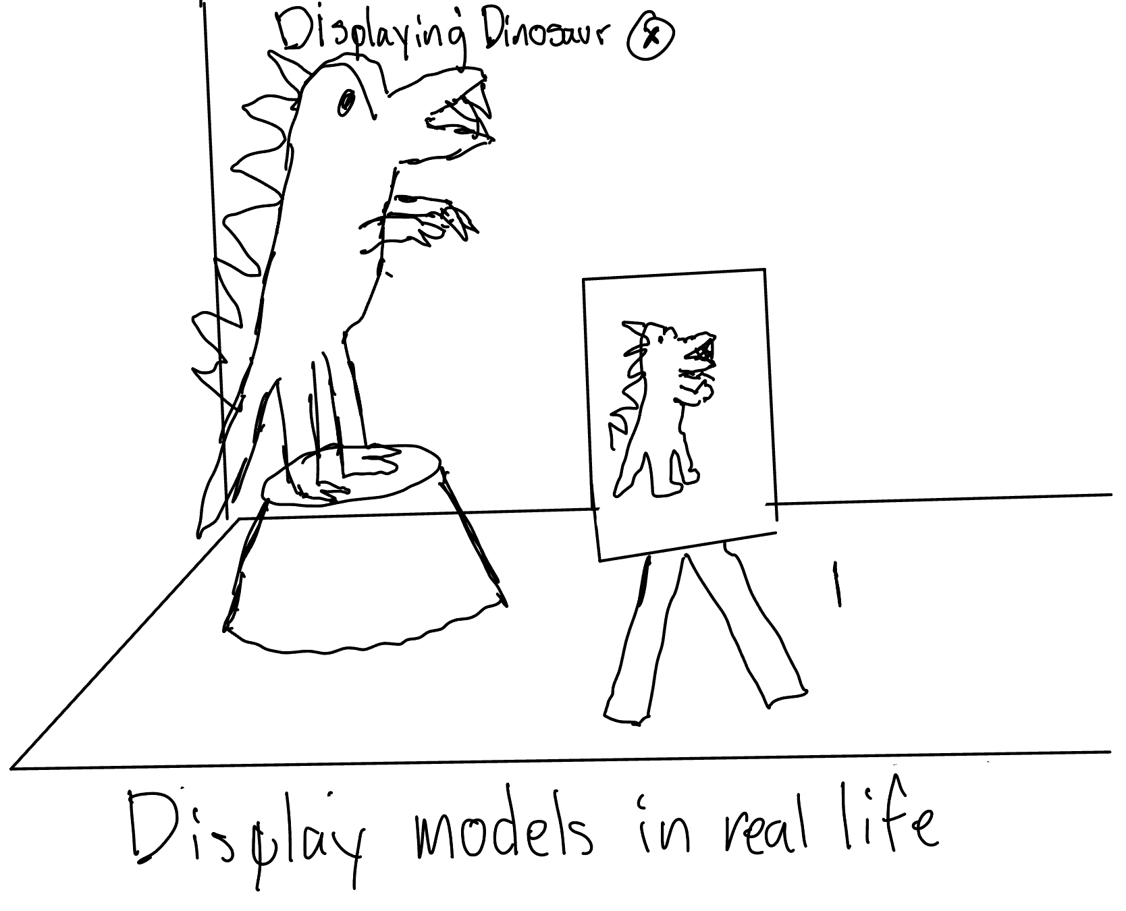
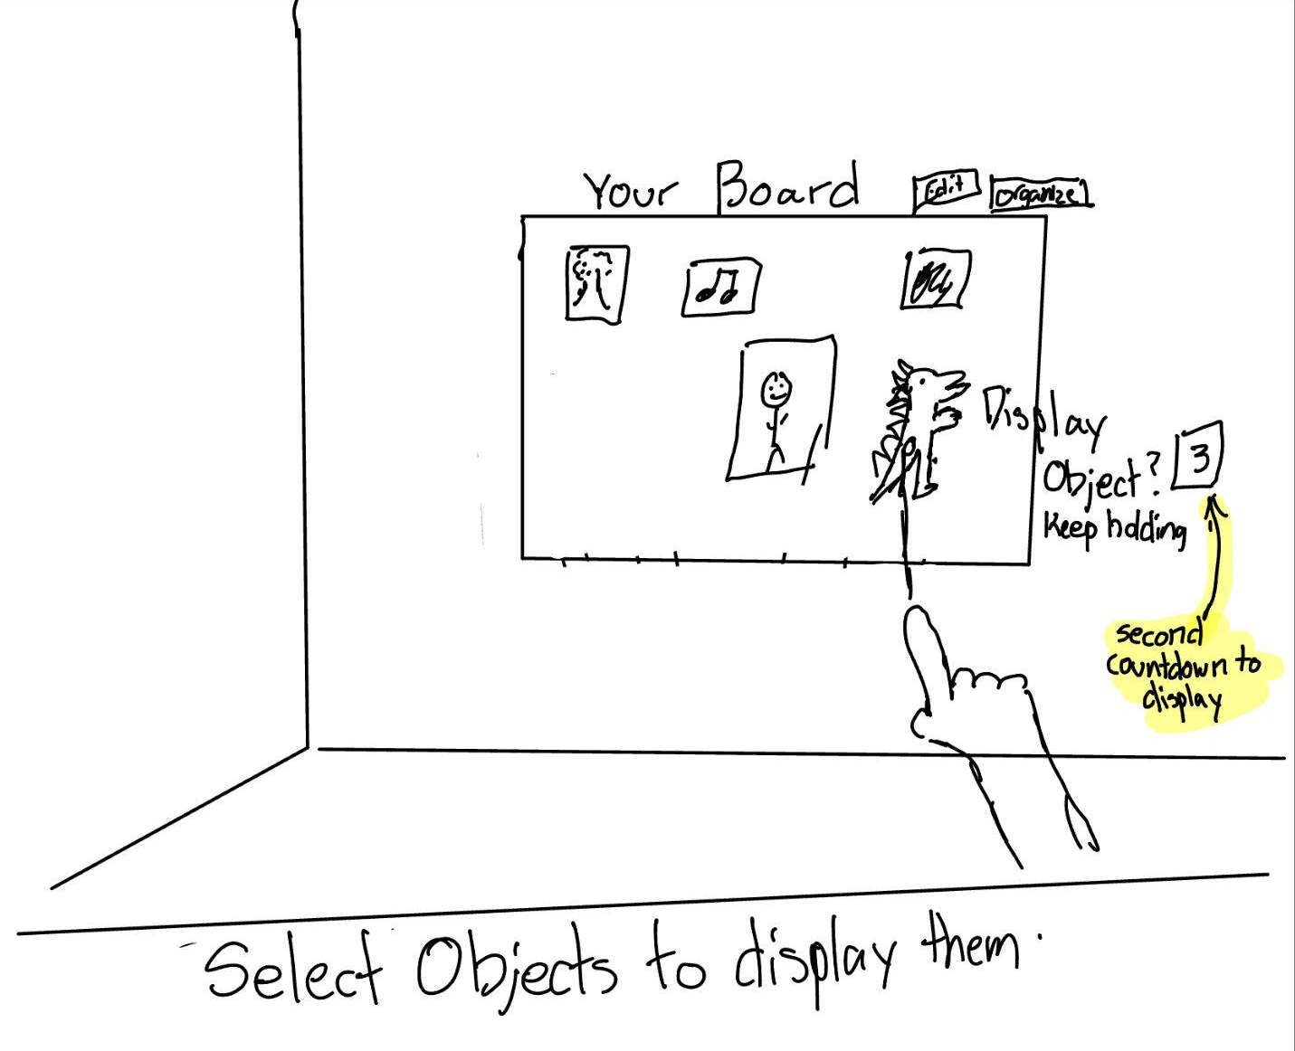
AR Screens
Notes:
What are some similarities and differences between the products? What has (and has not) worked for them? What makes your solution concept unique? What are the implications on your solution?

Slide 19
Pros and Cons

Slide 20
Mobile App Pros & Cons
Pros
Cons
Lightweight and highly accessible
Accepts multimedia inputs (photo, audio, video, text)
Syncable with other ecosystems (ex. Spotify for music)
Meets users where they’re at
Limited screen space to organize ideas
Grounded in 2D space, which hinders artists ability to be immersed in their environment
Overload of alternate mobile applications
Hard to scale down some inputs like films into an app
Notes:
What are some similarities and differences between the products? What has (and has not) worked for them? What makes your solution concept unique? What are the implications on your solution?

Slide 21
AR Pros & Cons
Pros
Cons
More immersive and can replicate original experiences/emotions more closely
High degrees of customization in the creative/organizing space
Allows user to capture higher fidelity visuals
Can help artists with limited access to space feel more free
Not accessible (requires special equipment)
Steeper learning curve and less intuitive as this is a more novel solution
Artists are apprehensive about new technology and have established habits
Harder to document spontaneous moments
Notes:
What are some similarities and differences between the products? What has (and has not) worked for them? What makes your solution concept unique? What are the implications on your solution?

Slide 22
Selected Solution

Slide 23
Chosen Solution
Mobile App
Why?
Largest pain points deal with accessibility over immersion
Another large pain point is the ability to add different mediums–mobile phones tend better to this as it most people’s primary means for media consumption (music, social media, photo-taking)
Must be intuitive for the artists to quickly upload content, thus a friendlier learning curve is needed
Artists tend to be averse to technology, so an extreme solution is not appropriate for our user demographics

Slide 24
Storyboard

Slide 25
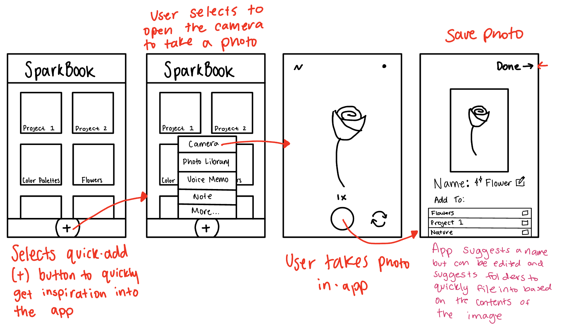
StoryBoard: Simple Task
Taking a photo of a spontaneous source of information and save it into a folder/project.
Notes:
What are some similarities and differences between the products? What has (and has not) worked for them? What makes your solution concept unique? What are the implications on your solution?

Slide 26
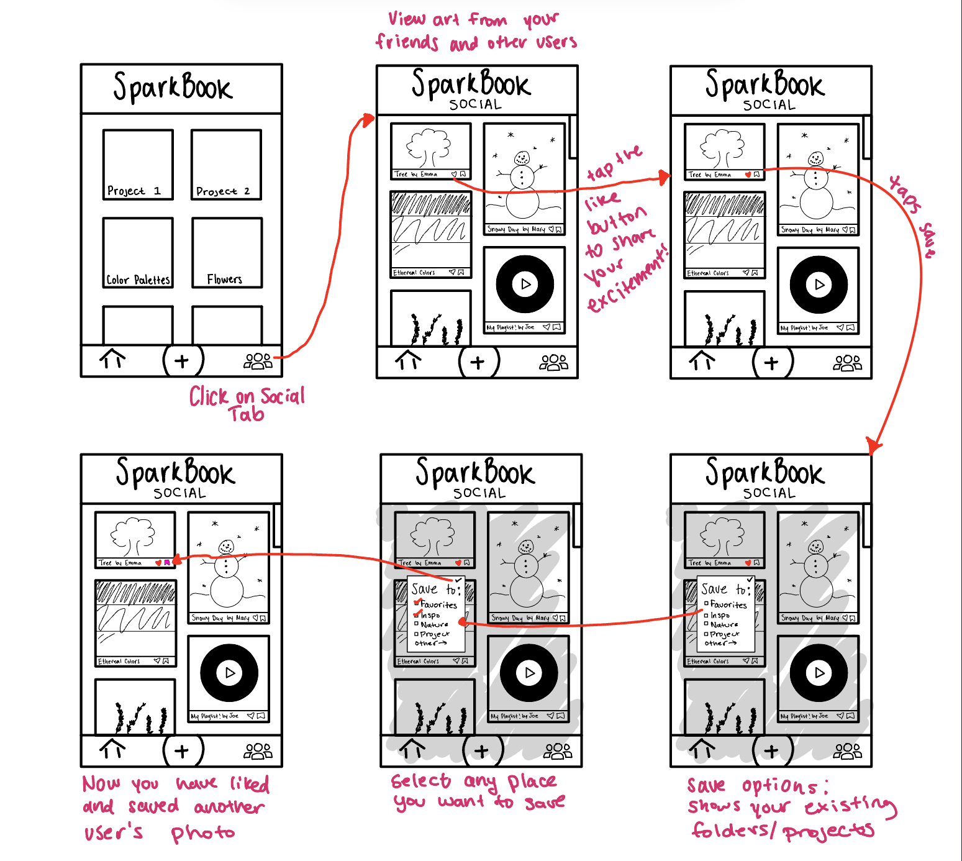
StoryBoard: Moderate Task
Viewing the social feed of other people’s art and saving someone else’s piece to one of your own inspiration folders
Notes:
What are some similarities and differences between the products? What has (and has not) worked for them? What makes your solution concept unique? What are the implications on your solution?

Slide 27
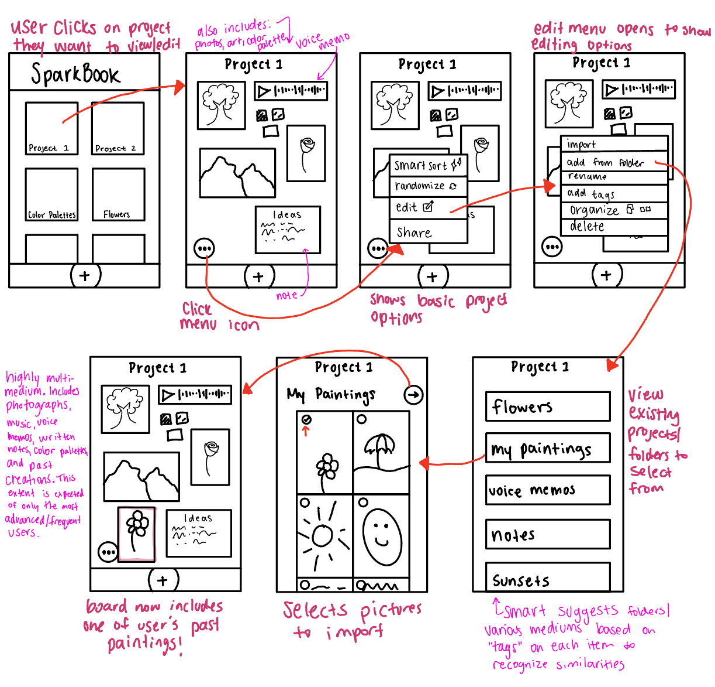
StoryBoard: Complex Task
Compiling all the different multimedia forms of inspiration (music, notes, images, people, their own work, voice recording) in one place
Notes:
What are some similarities and differences between the products? What has (and has not) worked for them? What makes your solution concept unique? What are the implications on your solution?

Slide 28
Low-Fidelity Prototype

Slide 29
Key components of Snyder’s Method
Roles in the test
During the paper prototype usability test, the facilitator, computer, and note-taker roles were assigned.
Prototype materials
Prototype was handmade (paper) and had cutouts to display pop-ups & menus. We drew the user’s inspirations on the spot and adapted during the session (e.g. they wanted to add a quick note within the board).
Testing procedure
We prepared an example scenario (with our three tasks) and debriefed and discussed with the user to gain a better understanding of their experience
Data gathered
We gathered:
- Quantitative (error counts & succession rates)
- Qualitative (user confusion & comments
- Usability insights
Notes:
What are some similarities and differences between the products? What has (and has not) worked for them? What makes your solution concept unique? What are the implications on your solution?

Slide 30
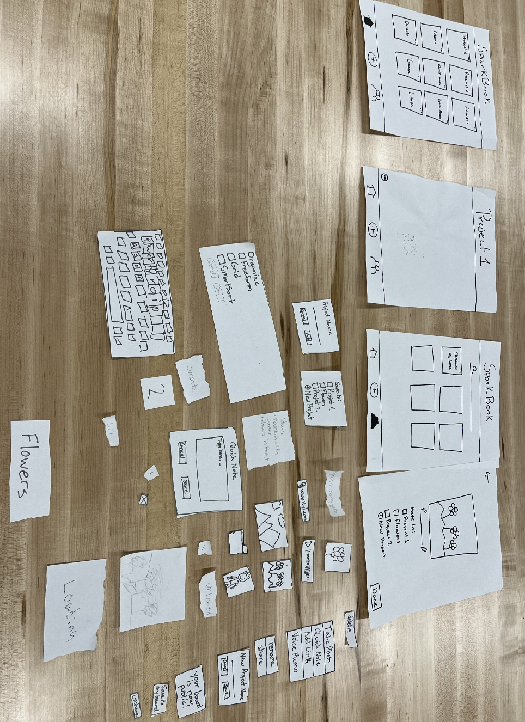
Our Low-Fi Prototype
Takeaways from Snyder:
Buttons and checkboxes to represent the user’s selection and options
Text fields where users can input their own words
Drop-down lists to reveal more information
Software background
Blowing up small-screen interfaces
Notes:
What are some similarities and differences between the products? What has (and has not) worked for them? What makes your solution concept unique? What are the implications on your solution?

Slide 31
Testing Procedure
Setup

Slide 32
ENVIRONMENT & APPARATUS
We created a paper prototype and manually responded to user actions. These paper prototypes were then laid out on a table in front of our participants as we consulted our script

Slide 33
Team member roles
Elijah
Luiza
Claire
Mikela
Computer
Facilitator
Note-taker
Note-taker

Slide 34
PROCEDURE
& PROCESS
Give users more context behind SparkBook
Demonstrated how to “talk through” their thinking
Present hypothetical scenarios
Assessed how easily users did tasks
Gathered thoughts on overall app use

Slide 35



Key Metrics
Intuitive Navigation
Ease of Task Execution
Eagerness to Use App
Measure # of misclicks in performing a task
Ask how difficult it was to navigate the app on a scale of 1-10
Ask how likely they are to use different features of the app on a scale of 1-10

Slide 36
Usability Goals
Usability Goal 1
Usability Goal 2
Flexible: It is adaptable to different sources of inspiration and organization preferences.
Efficient: The user is able to easily perform key tasks throughout the app
Process data
Process data
- What types of inspiration sources were added
- How users choose to organize their work (gird, free form, smart sort)
- User hesitation/confusion points
Bottom-Line data
Bottom-Line data
- How many users were successfully able to add their inspo source.
- How many users used the organization features
- Error rate
Notes:
for each that will help you continually assess whether your prototype is achieving its goals. Include both process data (i.e., what is happening) and bottom-line data (e.g., time spent per task or # of errors). These will be revisited in A6 as you iterate. Explain why the selected usability goals are logical based on the current progress of the project, and what these goals mean for your particular solution moving forward.

Slide 37
Test Results

Slide 38
Flexibility: Process data
What types of inspiration sources were added
Participant 1 searched the internet for a cartoon she enjoyed
Participant 2 went to a website to see the vases she liked
Participant 3 scrolled through her photo gallery and found a sunset
Participant 4 found a song that she enjoyed listening to
How users choose to organize their work
Only one participant was able to easily identify the button to organize their board.
None of the participants chose the “Smart sort” feature
Most participants chose to freely organize their board

Slide 39
Flexibility: Bottom line data
Successful addition of inspo sources
Most participants were able to easily identify the “+” button to add their sources of inspiration.
One participant wanted to add her inspiration by clicking on the board itself.
How many users used the organization feature
Only 1 participant easily found the three dots button at the corner of the board to select the different organization modes.
2 participants did not click on or notice that button at all.
1 participant was able to click on the three dots only in the second time that she saw the board.
This participant mentioned that if the facilitator hadn’t asked her to explore ways to organize the board, she wouldn’t have noticed.

Slide 40
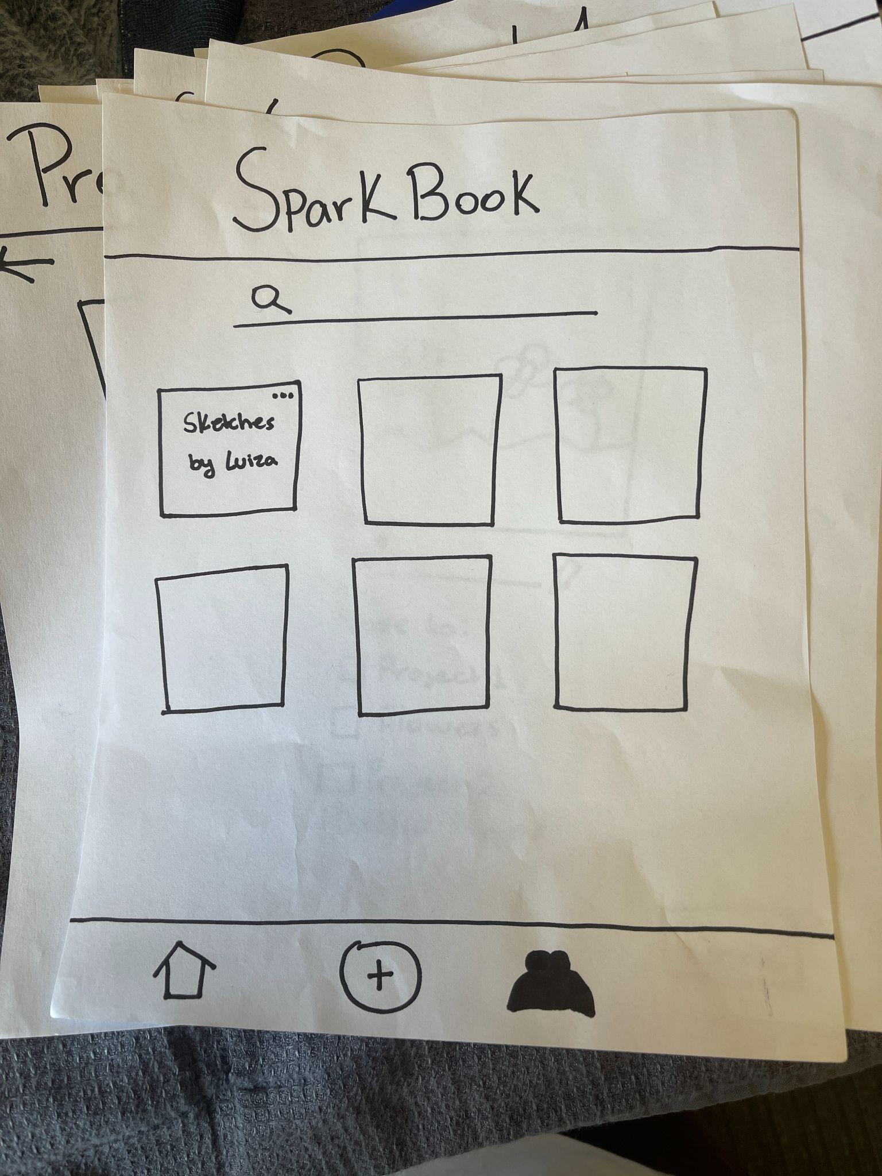
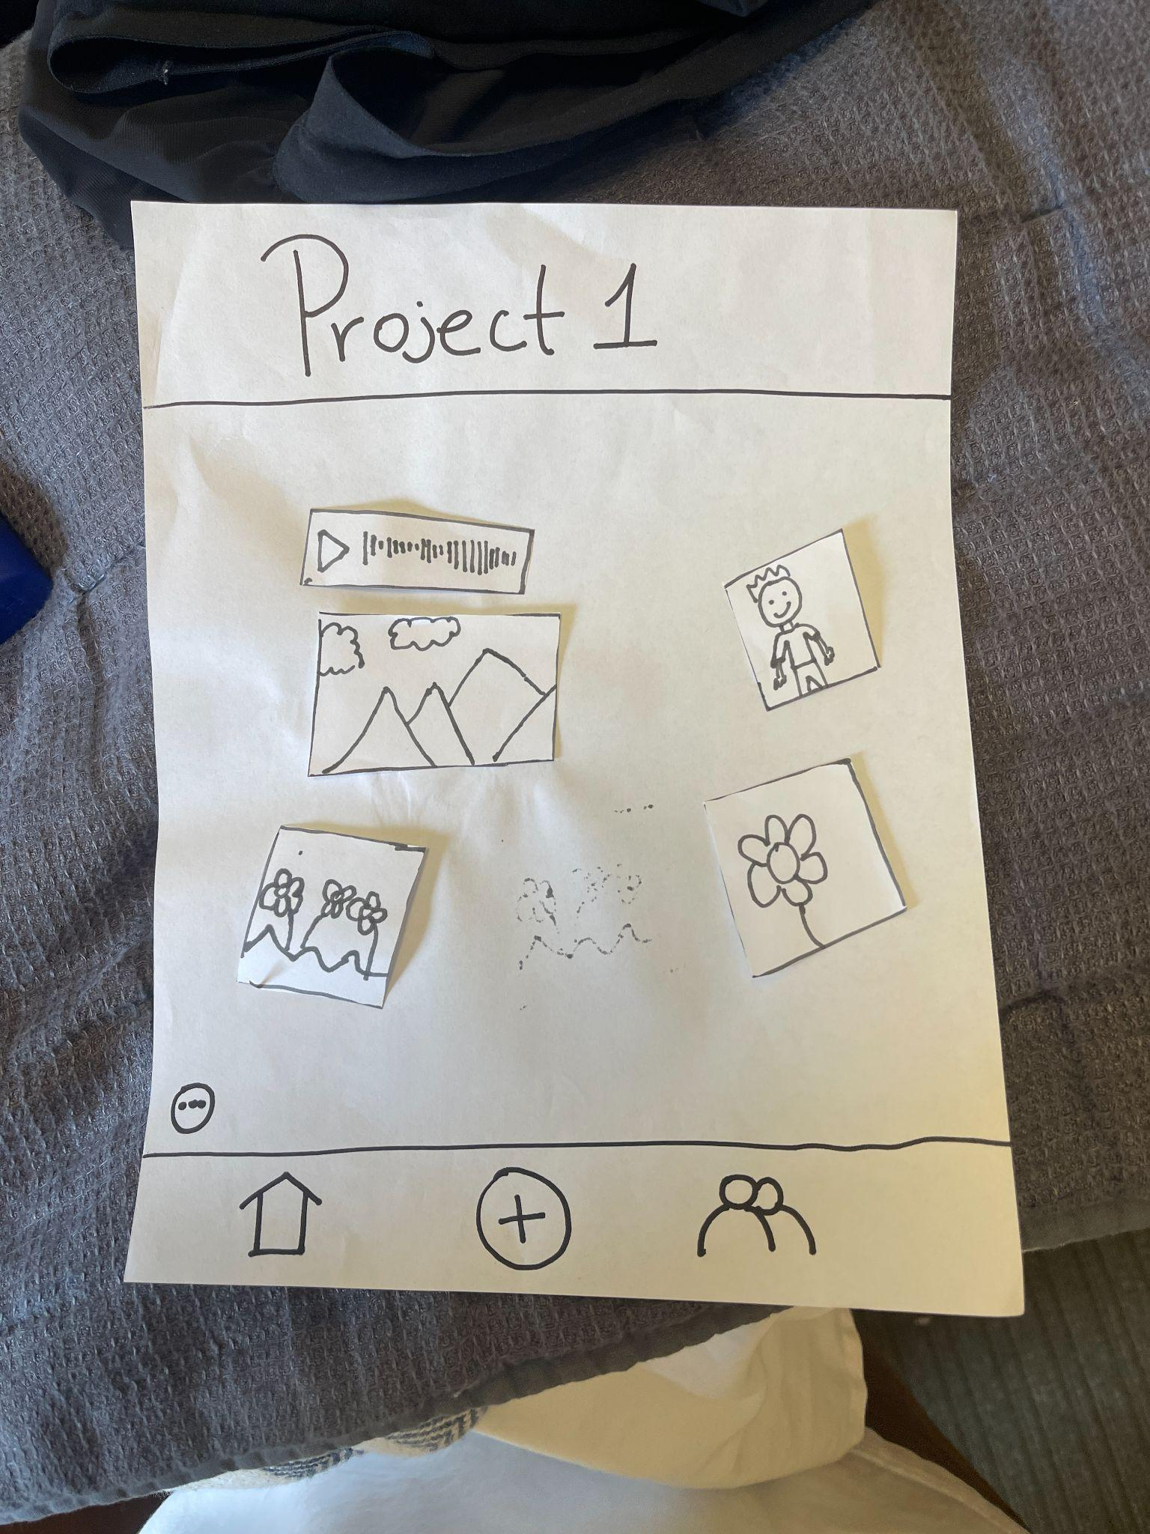
Efficient: Process data
User hesitation/confusion points
There was some confusion in trying to share your board to the community. Many users thought that all of the community related activities would be in the community page.
One participant was confused about adding an inspiration when they are already inside the board.

Slide 41
Efficient: Bottom line data
Error rate
6 total misclicks across all users throughout the different tasks
Task 1 had the highest success rate (it was more clear for users to know how to add an inspiration source)
Task 2 had the most misclicks (users were confused as to how to share their own board within the community)
But found it easy to save other people’s board to their own boards.

Slide 42
Task 1 -
Adding an inspiration
2 Misclicks
When one participant wanted to add something while she was in the board, she had a hard time identifying that she could press the add button again.

Slide 43
Task 2 -
Sharing your board to the community
4 Misclicks
3 participants thought that the community button would have an option to share your board with the community.
“Community space seems like it would be for sharing own work” - Mel

Slide 44
Task 3 -
Organizing your board
0 Misclicks
However 2 out of the 4 participants did not use the organization feature and manually organized it instead.
“Button to organize was hard to see. Not clear to be for organization” - Grace

Slide 45
Person #1: Lyla
Person #2: Mel
Person #3: Grace
Person #4: Mary
Task 1
Task 1
Task 1
Task 1
Task 2
Task 2
Task 2
Task 2
Task 3
Task 3
Task 3
Task 3
About: Art history and English double major, passionate about film production.
Age: 20
Age: 20
About: Enjoys creating pottery and ceramics
Age: 35
About: Creates physical design prototypes and enjoys music.
Age: 28
About: Enjoys creating poetry and music
Age: 53
0 misclicks - Was able to quickly identify how to add her source of inspiration.
1 misclicks- First clicked on the individual boards instead of the plus sign.
0 misclicks - Was able to quickly identify how to add her source of inspiration.
1 misclicks - Quickly identified the add button. But when she was in the board and wanted to add a note, she clicked in the board.
1 misclick - Clicked on the community icon and then clicked on the three dots inside the project.
2 misclicks - Spent a long time in the community page.
1 misclick - Clicked the plus button first.
0 misclicks - Easily identified the three dots to share the specific board to the community.
0 misclicks - Was able to easily identify the three dots at the bottom of the page for organization.
Was not able to identify the organization button.
Took a while to find the organize button. Noted that she did not know if there was anything to organize it with.
Was not able to identify the organization button.

Slide 46
OVERVIEW
6
Total misclicks
3/10
Difficulty navigating
(1-10) 10 being the hardest
7/10
Likelihood of using the app
(1-10) 10 being the most likely

Slide 47

Takeaway #1
Design Changes
Multiple users had trouble finding the automated organization features and resorted to freeform
We need a clear way for users to organize their boards
Replace with a button that correlates with organization on a higher level

Slide 48
Takeaway #2
Design Changes
Multiple users initially believed the community page would provide a space for them to share their items. They didn’t expect the only way to share to be on the home page.
We should provide a clear share button on the community page
It might also be helpful for users to be able to view the items that they have shared on the community page as well

Slide 49
Takeaway #3
Design Changes
Some users might want an easier way to add items to a board they are already in. The add button at the bottom creates an extra step of picking which project to save it in.
We should provide an easy way for users to add items to a board.
We could implement a radial menu that activates when holding on an empty spot on a project a user is in or provide options across the top of the project
Notes:
The add button adds an extra step to saving

Slide 50
Gaps in low-fi testing
Hard for users to actually try to import/upload various different sources of inspiration that they had in a paper prototype.
We couldn’t really see how effective the smart organization feature was.

Slide 51
Thank you!

Slide 52
Appendix

Slide 53
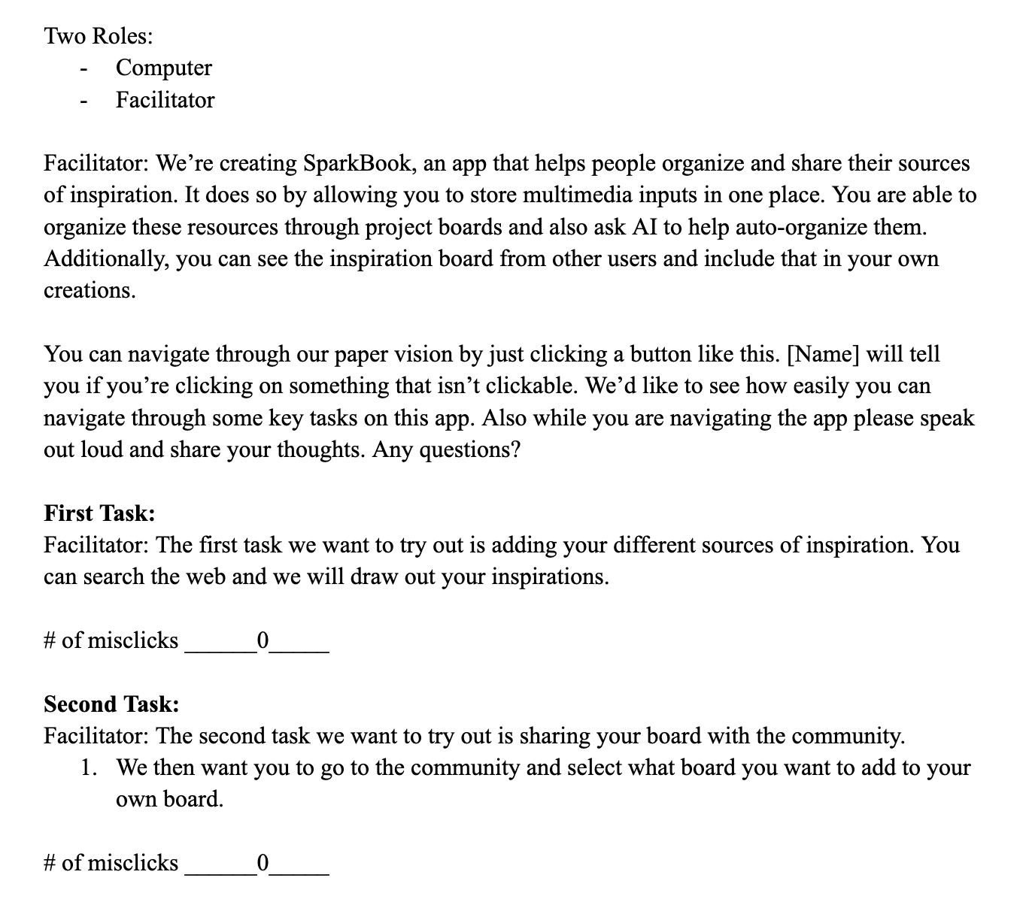
Script

Slide 54
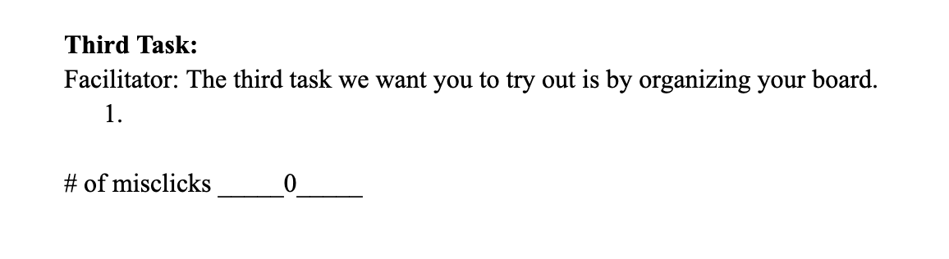
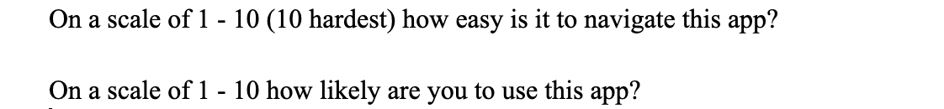
Script

Slide 55
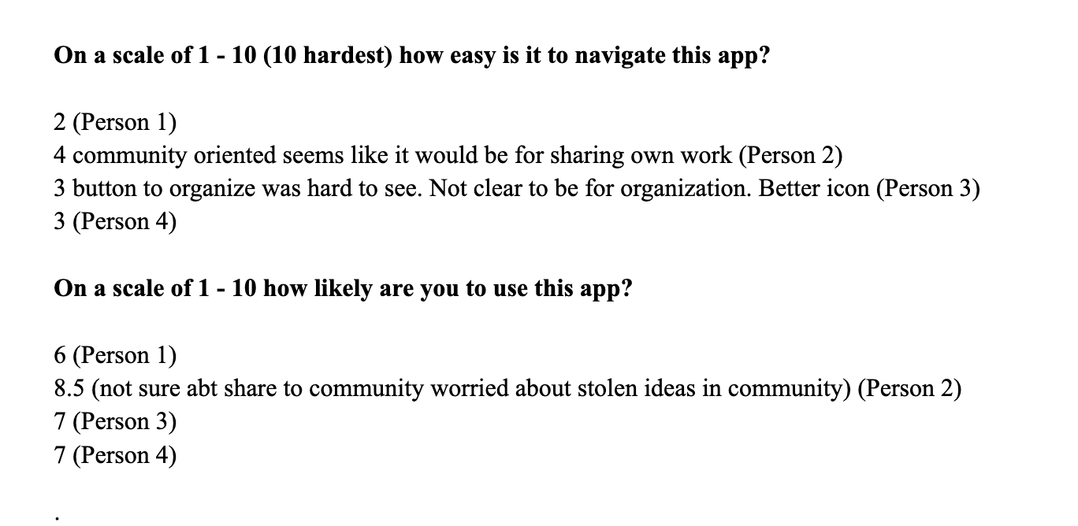
Results + Notes

